Slide 1

Phase 3 Presentation

Slide 2
A Reminder of Dollar Doodle
This is an innovative personal finance tracker that...
Helps users keep track of their spending.
Scan in receipts to make inputting transactions quicker.
Give AI suggestions to help the user improve their financial habits.
Notes:
Alex

Slide 3
Overview
1
2
3
4
DFD level zero and one
ERD diagram
Demonstration
Conclusion
Notes:
Alex

Slide 4
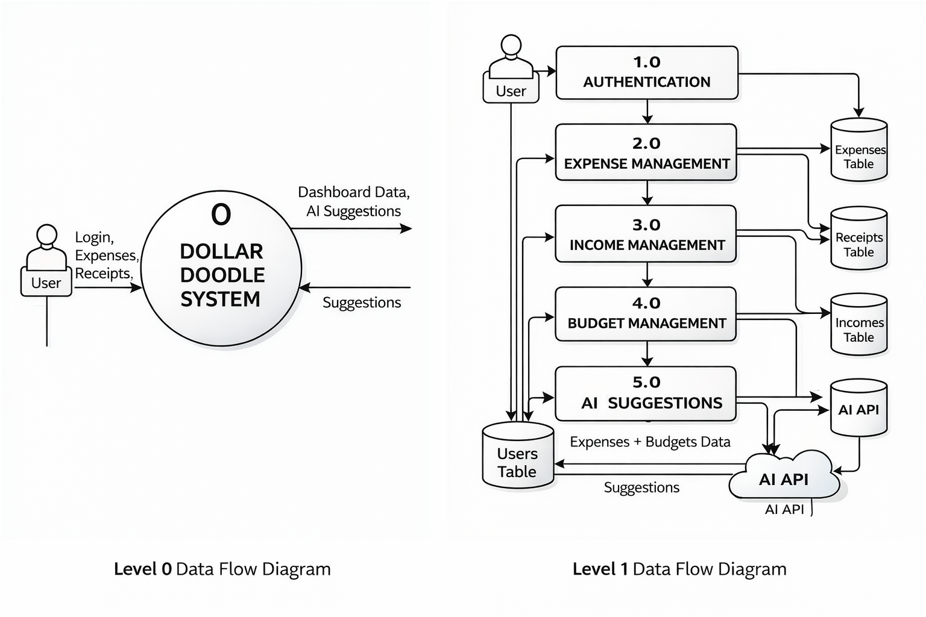
DFD Diagrams
Notes:
Eva

Slide 5
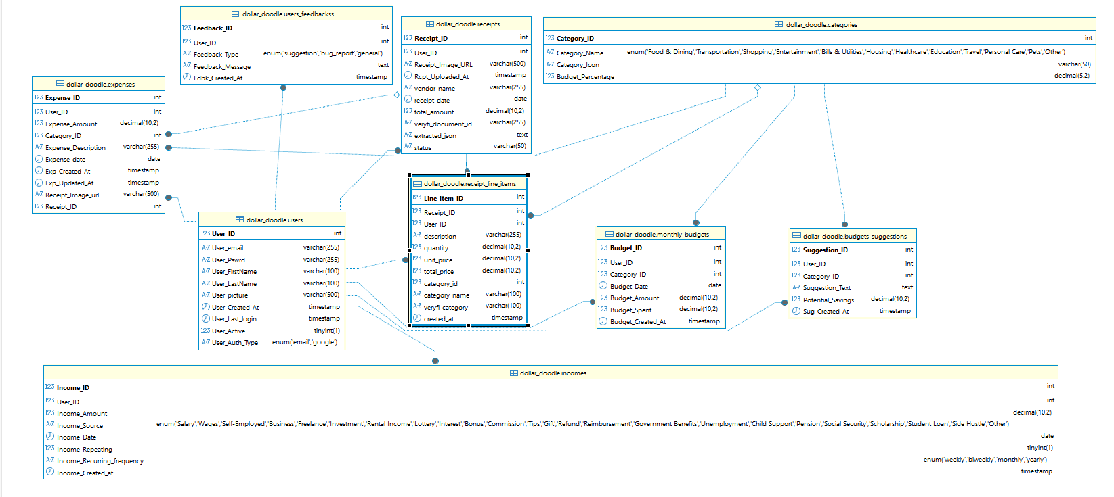
ERD Diagram
Notes:
Roma

Slide 6
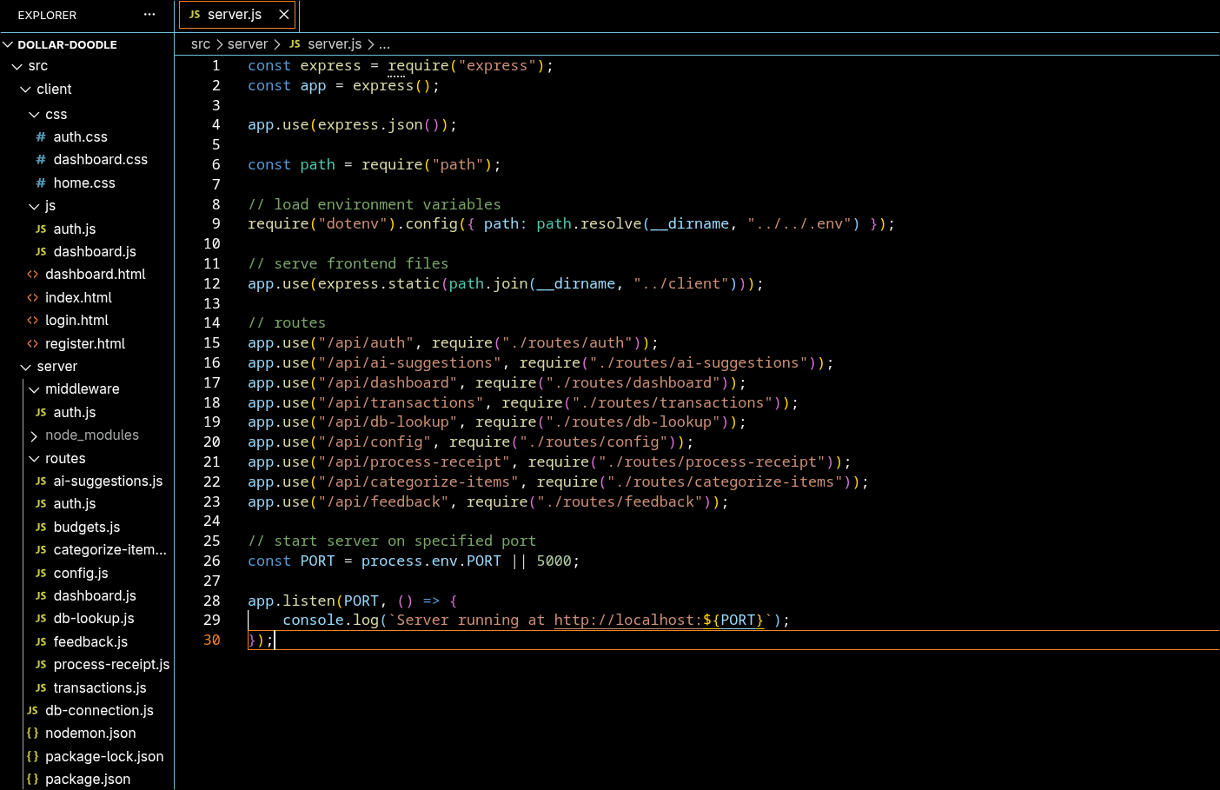
Server Structure
Notes:
Nick

Slide 7
We will demonstrate
 | Description
📷 Receipt Upload | Scan receipts with Veryfi OCR
💰 Expense Tracking | Manual or automatic transaction entry
🤖 AI Insights | Smart spending analysis and suggestions
✏️ Edit Transactions | Update expenses and incomes anytime
📊 Dashboard | View balance and transaction history
Notes:
Daniel

Slide 8
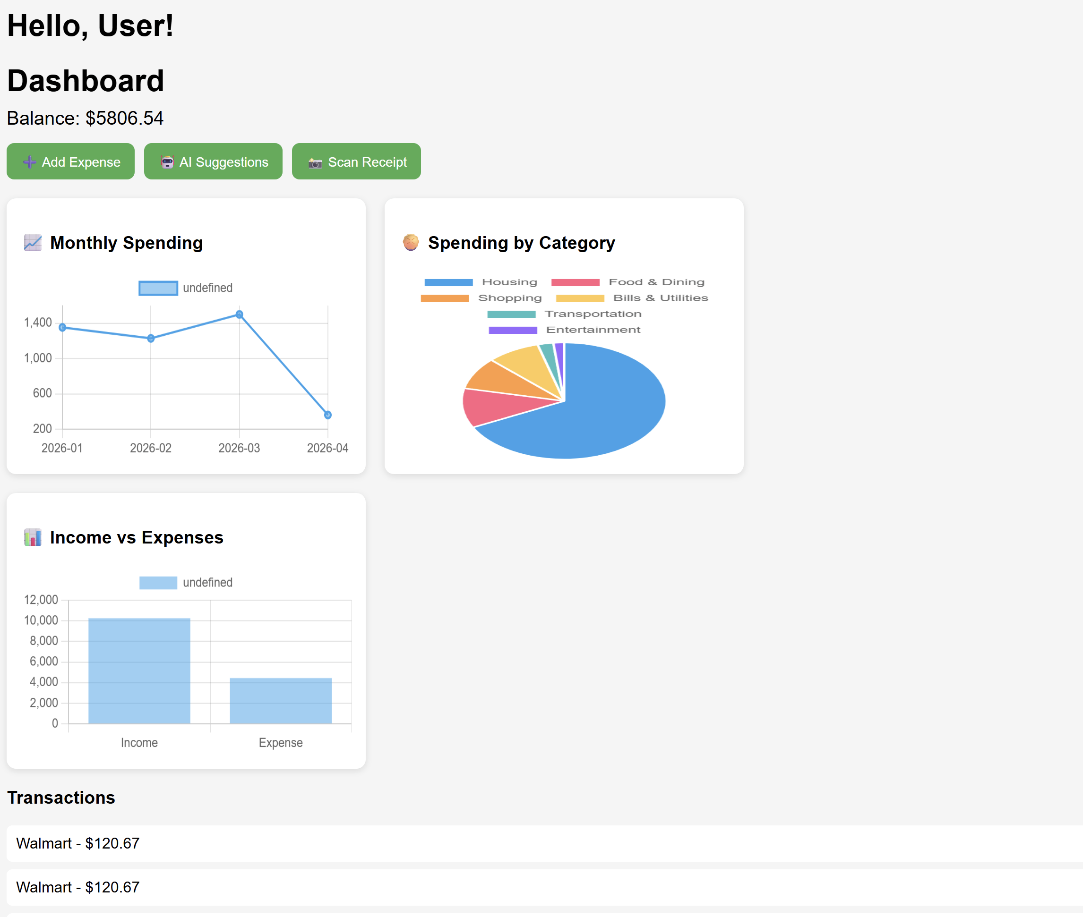
Graphs
Various types
Allowed for visual representation of trends/analyses
Plan to implement in Phase 4 and beyond
Notes:
Daniel

Slide 9
Conclusion
Dollar Doodle is more than just a regular personal finance application.
We use AI insights to help the user make better financial decisions.
User friendly interface allows for easy use of the application.
Many features that we covered that makes it easier to use.
Notes:
Alex

Slide 10
Team Responsibilities
Alex Hildreth
Project Manager
Nick Schott
Daniel Austin
Front End Development
Roumaysae Jerari
Eva Buesse
Back End Development
Contact Us: dollardoodledev@gmail.com
Notes:
Alex

